Slide 1
Introduction to JUnit
JVA-011
Notes:
Первый слайд всего курса.

Slide 2
Trainer
Andrey Parkhomenko
E-mail: aparkhomenko@luxoft.com

Slide 3
Module 1
What is Unit Testing
Notes:
*Слайд опционален
Для презентации, содержащей несколько модулей (т.е. разделитель частей презентации)

Slide 4
Unit testing
The goal of unit testing is to segregate each part of the program and test that the individual parts are working correctly
This means that for any function or procedure when a set of inputs are given then it should return the proper values
A unit test provides a written contract that the piece of code must assure

Slide 5
Unit testing
«White Box» testing method is used for executing the unit test
Unit testing should be done before Integration testing
Unit testing should be done by the developers

Slide 6
Why should we test?
to decrease the numbers of defects
higher quality of the product
to find the defect easier
unit testing allows to find problems early in the development cycle
to increase the documentation
each test case or scenario is an additional source of information which describes the usage and behavior of the system
to increase the development pace
reducing the technical debt on the way to deadline

Slide 7
Module 2
Unit testing with JUnit
Notes:
*Слайд опционален
Для презентации, содержащей несколько модулей (т.е. разделитель частей презентации)

Slide 8
JUnit test structure
Test case is a java class which contains a group of unit tests
Single test case naturally belongs to some class

Slide 9
JUnit test structure
1 2 3 4 5 6 7 8 9 | package io.tc.junit; import org.junit.Test; import org.junit.runner.RunWith; import org.junit.runners.JUnit4; import st.pr.strategy.Person; import st.pr.validator.ValidationResult; import st.pr.validator.Validator; import java.util.Set; import static org.junit.Assert.assertEquals; @RunWith(JUnit4.class) public class PersonValidatorTest { private Validator<Person> validator = PersonMandatoryFieldsValidator.getInstance(); @Test public void firstNameIsEmpty_validationError() { Person p = new Person(); p.setFirstName(""); validator.validate(p); Set<ValidationResult> validationErrors = validator.getErrors(); assertEquals( "Validation result should be as expected", validationErrors.stream() .map(ValidationResult::getMessage) .filter(m -> m.equals("First name should not be empty")) .count(), 1); } }
The standard runners are all in this package
Test class for the target class
Method is considered as test by JUnit
Checking whether result is expected

Slide 10
Running the test
Compile
$ javac -cp .:junit-4.12.jar -d out -sourcepath src/main/ src/test/com/luxoft/tc/junit/PersonValidatorTest.java -Xlint:unchecked
Run
$ java -cp out:junit-4.12.jar:hamcrest-core-1.3.jar org.junit.runner.JUnitCore com.luxoft.tc.junit.PersonValidatorTest
JUnit version 4.12
.
Time: 0,042
OK (1 test)

Slide 11
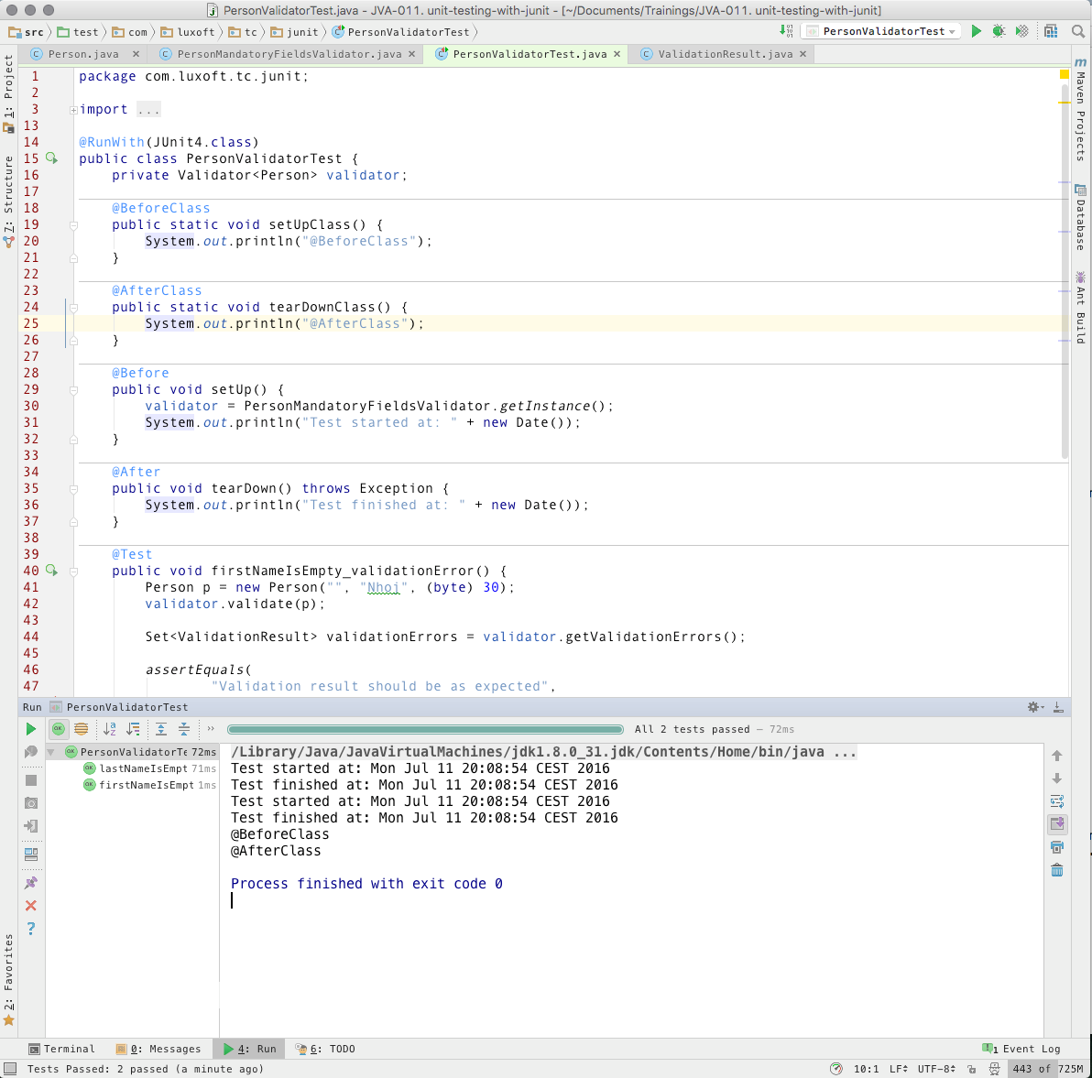
Running the test in IDE

Slide 12
JUnit basics
Each java method which represents a single test is marked as @Test
Different Test Runners are used to execute the test
Test could be ignored using @Ignore annotation.
Expected and actual results compares using Assertions — assertTrue, assertEquals, etc

Slide 13
Test fixtures
Text fixture is a fixed state of a set of objects used as a baseline for running tests.
Examples:
preparation of input data and setup/creation of fake or mock objects
loading a database with a specific, known set of data
copying a specific known set of files creating a test fixture will create a set of objects initialized to certain states.

Slide 14
Test fixtures
Test classes can have fixture
run before or after every test
run before and after only once for all test methods in a class
Fixtures:
class-level: @BeforeClass, @AfterClass
method-level: @Before, @After

Slide 15
Test fixtures
@RunWith(JUnit4.class) public class PersonValidatorTest { private Validator<Person> validator;
@BeforeClass public static void setUpClass() { System.out.println("@BeforeClass"); } @AfterClass public static void tearDownClass() { System.out.println("@AfterClass"); } @Before public void setUp() { validator = PersonMandatoryFieldsValidator.getInstance(); System.out.println("Test started at: " + new Date()); } @After public void tearDown() throws Exception { System.out.println("Test finished at: " + new Date()); } @Test public void firstNameIsEmpty_validationError() {
...
} }
}

Slide 16
Ignoring a Test
Delete the @Test annotation — that test will not be reported
Add the @Ignore annotation in front or after @Test — number of ignored tests will be reported
@Test @Ignore("Test is ignored as a demonstration") public void firstNameIsEmpty_validationError() { Person p = new Person("", "Nhoj", (byte) 30); validator.validate(p); assertTrue(!validator.getValidationErrors().isEmpty()); }
OK (1 test)

Slide 17
Tests execution order
No order by default — returned by Reflection API
JUnit > 4.11 — order is MethodSorters.DEFAULT
Use @FixMethodOrder to change the order:
@FixMethodOrder(MethodSorters.NAME_ASCENDING)
@FixMethodOrder(MethodSorters.JVM)

Slide 18
Tests runners
Console based
NetBeans, Eclipse and IntelliJ Idea have native graphical test runners built in.
@RunWith(<Runner Class>)
Suite, Parameterized, Categories
Third Party: SpringJUnit4ClassRunner, MockitoJUnitRunner, HieratchicalContextRunner, etc
java org.junit.runner.JUnitCore TestClass1 [...other test classes...]

Slide 19
Test timeout
@Test(timeout=<msec>)
@Rule for timeout — will be applied for all the test
including any @Before and @Afeter methods
@Test(timeout=1000)
public void testWithTimeout() {
...
}
@Rule
public Timeout globalTimeout = Timeout.seconds(10);

Slide 20
Test suites
Possibility to run the tests from many classes
@RunWith(Suite.class) and @SuiteClasses(TestClass1.class, ...)
org.junit.runners.Suite runner will be used
import org.junit.runner.RunWith; import org.junit.runners.Suite; @RunWith(Suite.class) @Suite.SuiteClasses({ PersonFieldsValidatorTest.class, PersonBehaviorValidatorTest.class}) public class WorkflowValidationTestSuite { // the class remains empty, // used only as a holder for the above annotations }

Slide 21
Assertions
Assertion – is an opportunity to verify that some condition holds true.
Classic-style-assertions + Hamcrest (aka Matchers)
import static org.junit.Assert.*;
import static org.hamcrest.CoreMatchers.*
assertArrayEquals
assertEquals
assertFalse
assertNotNull
assertNotSame
assertNull
assertSame
assertThat
assertTrue
allOf
anyOf
both
containsString
equalTo
everyItem
hasItems
not
sameInstance
startsWith

Slide 22
Assertions
@Test
public void testAssertEquals() {
assertEquals("failure - strings are not equal", "text", "text");
}
@Test
public void testAssertFalse() {
assertFalse("failure - should be false", false);
}
@Test
public void testAssertNotNull() {
assertNotNull("should not be null", new Object());
}
@Test
public void testAssertNotSame() {
assertNotSame("should not be same Object", new Object(), new Object());
}
@Test
public void testAssertNull() {
assertNull("should be null", null);
}

Slide 23
Matchers
Syntax
assertThat([value], [matcher statement]);
import static org.hamcrest.CoreMatchers.*;
Examples
assertThat(x, is(3));
assertThat(x, is(not(4)));
assertThat(responseString, either(containsString("color")).or(containsString("colour")));
assertThat(myList, hasItem("3"));
Additional
Excel spreadsheet matchers
JSON matchers
XML/XPath matchers

Slide 24
Exception testing
Using annotation parameter
@Test(expected = IndexOutOfBoundsException.class)
public void empty() {
new ArrayList<Object>().get(0);
}
Using ExpectedException Rule
@Rule
public ExpectedException thrown = ExpectedException.none();
@Test
public void shouldTestExceptionMessage() throws IndexOutOfBoundsException {
...
list.get(0); // execution will never get past this line
}

Slide 25
Parameterizing testing
Custom runner
@RunWith(Parameterized.class)
@Parameters - org.junit.runners
@Retention(RetentionPolicy.RUNTIME)
@Target({ElementType.METHOD})
public @interface Parameters {
String name() default "{index}";
}
Example
@Parameters
public static Iterable<? extends Object> data() {
return Arrays.asList("first test", "second test");
}

Slide 26
Parameterizing testing
@Parameter - org.junit.runners
@Retention(RetentionPolicy.RUNTIME)
@Target({ElementType.FIELD})
public @interface Parameter {
int value() default 0;
}
Example
@Parameter(value = 1)
public int expected;

Slide 27
JUnit and maven integration
It’s supposed to be automatic, but you still have to press the button.
—John Brunner
<dependency>
<groupId>junit</groupId>
<artifactId>junit</artifactId>
<version>4.12</version>
<scope>test</scope>
</dependency>
<build>
<plugins>
[...]
<plugin>
<artifactId>maven-surefire-plugin</artifactId>
<configuration>
<includes>**/Test*.java</includes>
</configuration>
</plugin>
[...]
</plugins>
</build>
TODO: example

Slide 28
JUnit and gradle integration
apply plugin: 'java'
dependencies {
testCompile 'junit:junit:4.12'
}
In order to be more Maven-like, starting in version 4.11, there is only the junit:junit artifact which
uses a transitive dependency on hamcrest-core
./gradle test

Slide 29
FIRST properties of a good test
Fast
Isolated
Repeatable
Self-validating
Timely

Slide 30
Right-BICEP
Right - Are the results right?
B — Are all the boundary conditions correct?
I — Can you check inverse relationships?
C — Can you cross-check results using other means?
E — Can you force error conditions to happen?
P — Are performance characteristics within bounds?

Slide 31
Boundary conditions — CORRECT
Conformance—Does the value conform to an expected format?
Ordering—Is the set of values ordered or unordered as appropriate?
Range—Is the value within reasonable minimum and maximum values?
Reference—Does the code reference anything external that isn’t under direct control of the code itself?
Existence—Does the value exist (is it non-null, nonzero, present in a set, and so on)?
Cardinality—Are there exactly enough values?
Time (absolute and relative)—Is everything happening in order? At the right time? In time?

Slide 33
Pragmatic Unit Testing in Java with Junit (Pragmatic Programmers) Andy Hunt, Dave Thomas
Growing Object-Oriented Software, Guided by Tests Steve Freeman, Nat Pryce
JUnit in Action, Second Edition Petar Tahchiev, Felipe Leme, Vincent Massol, and Gary Gregory
https://github.com/junit-team/junit4/wiki

